Slide 1

Differences between High School and College
Institute for Community Inclusion
UMass Boston

Slide 2

What Students Have to Say:
“Here’s what college has taught me about myself: (1) I’ve learned how to be more aware; (2) I learned more about who I am as a person; (3) I’ve learned how to be an independent and responsible person; and (4) I’m learning to be more focused.”
--Grace, 21
Notes:
[We would like to have someone read this and provide the audio]
Grace summarizes what college has taught her: Here’s what college has taught me about myself: (1) I’ve learned how to be more aware; (2) I learned more about who I am as a person; (3) I’ve learned how to be an independent and responsible person; and (4) I’m learning to be more focused.

Slide 4
In this section:
Differences between the Individuals with Disabilities Education Action (IDEA) and the Americans with Disabilities Act (ADA) and Section 504 of the Rehabilitation Act

Slide 5
Choose the false statement :
Colleges are required to identify students with disabilities to provide them services.
In high school, students with disabilities are entitled to receive services.
In college, students with disabilities are supported in accessing college courses.
Notes:
[Vocab words on this slide:
Entitled: a right to benefits specified by law or contract]

Slide 6
Q: Colleges are required to identify students with disabilities to provide them services.
A: Correct! This is the false statement.
Colleges are not required to identify students with disabilities. In a college setting, it is the responsibility of the student to identify themselves to the disability services office and to ask for help.

Slide 7
Q: In high school, students with disabilities are entitled to receive services.
A: Better luck next time! This statement is true.

Slide 8
Q: In college, students with disabilities are supported in accessing college courses.
A: Sorry! This statement is true.

Slide 9
Legal Differences: IDEA vs. ADA
High School | College
Individuals with Disabilities Education Act (IDEA) | Americans with Disabilities Act (ADA) and Section 504 of the Rehabilitation Act
Entitlement | Non-Discrimination
Success | Access
Notes:
[Under “entitlement”]
IDEA, an entitlement law that guarantees students with disabilities a free and appropriate public education until the age of 22.
IDEA holds that education is a right and must be provided to all individuals in an environment that ensures their success.
[Under right column]
Statutes based on a civil rights model. The goals are to remove barriers to provide persons with disabilities the opportunity to participate in an educational setting.
[Vocab words on this slide:]
Entitlement: a right to benefits specified by law or contract
FAPE: a Free Appropriate Public Education, the right of all students (including those with disabilities) to have access to public education]

Slide 10

Impact on Students with ID
Taking college courses
Negotiated on a case-by-case basis
Colleges/Universities not legally required to allow participation of students not deemed “otherwise qualified”
Staff from established programs may assist
Appropriate supports = students finding success
Notes:
[Vocab words on this slide:
otherwise qualified: when a student meets the same academic requirements and standards as non-disabled students]

Slide 11
Learning Unit Objectives

Slide 12
In this section:
Differences between Individualized Education Programs (IEPs) and Disability Services

Slide 13
Choose the false statement:
A college is required to follow what is written in a student’s IEP.
In high school, significant modifications to the curriculum are allowed depending on the student’s disability.
In college, the Disability Services Office and the student discuss what types of accommodations might be appropriate.
Notes:
[Vocab words on this slide:
IEP: Individualized Education Program, a unique plan designed to meet the educational needs of a student with a disability
Modifications: significant changes to the content of an academic program (e.g., taking a different test than the rest of the class)
Accommodations: do not modify content, but allow a student with a disability to receive information or to demonstrate what they’ve learned in a way that minimizes the effect of their disability (e.g., preferential seating, a notetaker, extended testing time)
Disability Services Office: the department within a college or university responsible for working with students with disabilities to provide and arrange for accommodations]

Slide 14
Q: A college is required to follow what is written in a student’s IEP.
A: You chose correctly! This is the false statement.
College faculty are not required to follow what is written in a student’s IEP. There are no IEPs in college. Instead, the Disability Services office, along with the student, and based on the documentation provided, will determine appropriate accommodations.

Slide 15
Q: In high school, significant modifications to the curriculum are allowed depending on the student’s disability.
A: Sorry! This statement is true.

Slide 16
Q: In college, the Disability Services Office and the student discuss what types of accommodations might be appropriate.
A: Try again! This statement is true.

Slide 17
Individualized Education Programs (IEP) vs. Disability Services
High School | College
Modifications | Accommodations
IEP Team | Disability Services Office
Notes:
[expand under title]
In high school, students with disabilities often have IEPs that outline modifications to academic content. There are no IEPs in college, instead students receive accommodations through the Disability Services Office, but no changes to the academic content can be made.
[Expand under modifications]
Example:
A student’s IEP includes that he/she take a test with a different set of questions than other students and is allowed a longer period of time to take that test.
[Expand under accommodations]
Example:
The student will take the same test, with the same questions as other students, but educational supports includes extra time to complete the test.

Slide 18

Impact on Students with ID
If taking classes for credit, modifications in course content generally not allowed
If not receiving course credit, individual expectations (including modifications) may be worked out
If still in high school, modifications listed in the IEP are not enforced
Notes:
[Vocab words on this slide:
Modifications: significant changes to the content of an academic program (e.g., taking a different test than the rest of the students in the class)]

Slide 19

What students have to say:
“If you have a certain disability and want to go to college you need to sign up in the disability office if they have one. The student needs to have paper work that documents their disability. After that, you can get help.”
- Beth, 20
Notes:
[We would like to have someone read this and provide the audio]
Beth, a student taking classes at Quinsigamond Community College says this about college: If you have a certain disability and want to go to college you need to sign up in the disability office if they have one. The student needs to have paper work that documents their disability. After that, you can get help.

Slide 20
Learning Unit Objectives

Slide 21
In this section:
Differences in asking for and getting help

Slide 22
Choose the false statement:
A high school will pay for and arrange testing to determine whether a student has a disability.
In college, a student can request help from the Disability Services Office if documentation is provided.
Colleges will pay for and arrange a personal care attendant for a student.
Notes:
[Vocab words on this slide:
Documentation: paperwork that proves a student has a diagnosed disability and that disability impacts their participation in school
personal care attendant: PCA, a paid, employed person who helps a person with a disability with activities of daily living]

Slide 23
Q: A high school will pay for and arrange testing to determine whether a student has a disability.
A: Try again. This statement is true.

Slide 24
Q: In college, a student can request help from the Disability Services Office if documentation is provided.
A: Good try! But this statement is true.

Slide 25
Q: Colleges will pay for and arrange a personal care attendant for a student.
A: Correct! This is the false statement.
A personal care attendant is considered a personal service, which the college is neither obligated to pay for and typically does not help the student arrange for one.

Slide 26
Differences in getting help
High School | College
School identifies a student with a disability (provides testing to determine a disability) | Student self-identifies to Disability Services Office (and provides documentation)
School arranges and provides personal services (e.g., personal care attendant) | Student arranges and pays for personal services
Notes:
[expand under 1st row]
The Disability Services Office requires proof of the student’s disability and testing generally needs to have been conducted within the last 3 years. If this proof does not exist, it is the student’s responsibility to get it. The college will not pay for testing, but may provide a list of where to get testing.
[expand under 2nd row]
Personal care services, are just that, personal. The college will not pay for, arrange or coordinate these services. The student must do this.

Slide 27
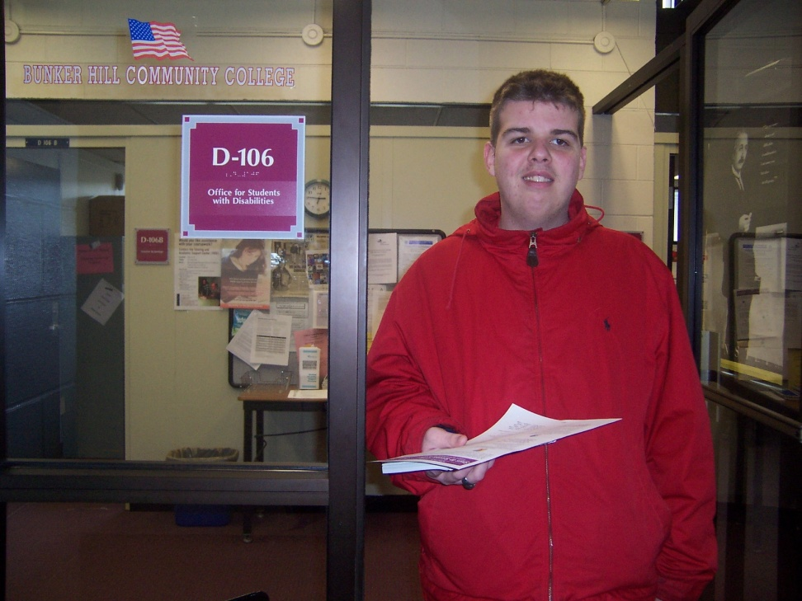
What students have to say:
“See, the difference between college and high school is how you get help. In college, you have to ask for it and look for help yourself. In high school, you don't even have to ask because they know you need help in some classes. Students need to understand that people aren't just going to come to you.”
-- Shannon
Notes:
[We would like to have someone read this and provide the audio]
Shannon is a young adult taking college classes and this is what she has to say about college: See, the difference between college and high school is how you get help. In college, you have to ask for it and look for help yourself. In high school, you don't even have to ask because they know you need help in some classes. Students need to understand that people aren't just going to come to you.

Slide 28
Learning Unit Objectives

Slide 29
In this section:
Differences between the Family Educational Rights Privacy Act (FERPA) in high school and college

Slide 30
Choose the false statement:
In college, parent input is not always actively sought and may be discouraged at times.
Students should practice advocating for themselves in high school in order to be prepared to take on this role in college.
College faculty or Disability Services staff will communicate directly with a student’s parents.

Slide 31
Q: In college, parent input is not always actively sought and may be discouraged at times.
A: Please try again, this statement is true.

Slide 32
Q: Students should practice advocating for themselves in high school in order to be prepared to take on this role in college.
A: Oops! Try again, this statement is true.

Slide 33
Q: College faculty or Disability Services staff will communicate directly with a student’s parents.
A: Right! This is the false statement.
College faculty or Disability Services staff will NOT communicate directly with a student’s parents because under FERPA in college, a student’s rights transfer to him/her.

Slide 34
Family Educational Rights Privacy Act (FERPA)
High School | College
Parents have certain rights | Rights transfer to student –age 18
School communicates with parent(s) | School communicates with student
Parent advocates (student may advocate as well) | Student must advocate
Notes:
[expand under 1st row]
High school students are typically minors (under age 18) which provides their parents with rights to their information. But most college are over18, thus making them an adult according to the law.
[expand under 2nd row]
College faculty, Disability Services, financial aid staff or the registrar will only communicate directly with a student, not his/her parents. College staff can only communicate private information to a student’s parents if he/she has given such permission.
[expand under 3rd row]
The college student is now considered to be an adult and must ask for help when necessary and resolve issues on their own to a certain extent. Parents will not be notified by the school or receive any information.

Slide 35

What students have to say:
“My best class is my Choral Class. It really helped me find my voice. Not just my singing voice. I’m speaking up for myself now in many different situations. I was quiet before but now, here I am, talking about college. It’s like, bam! I’ve got everything under control.”
--Arielle, 19
Notes:
[We would like to have someone read this and provide the audio]
Arielle is a 19-year old student, and this is what she has to say about learning to advocate for herself in college: My best class is my Choral Class. It really helped me find my voice. Not just my singing voice. I’m speaking up for myself now in many different situations. I was quiet before but now, here I am, talking about college. It’s like, bam! I’ve got everything under control.

Slide 36
Learning Unit Objectives

Slide 37
In this section:
The differences between the responsibilities of a high school student and a college student.

Slide 38
Choose the false statement:
In high school, teachers and parents make sure a student gets the help he/she needs to be successful even if the student hasn’t asked for help.
In college, faculty will structure a student’s time for him/her in order to meet assignment due dates.
In high school, parents attend IEP meetings and advocate for the student.

Slide 39
Q: In high school, teachers and parents make sure a student gets the help he/she needs to be successful even if the student hasn’t asked for help.
A: Sorry! This statement is true.

Slide 40
Q: In college, faculty will structure a student’s time for him/her in order to meet assignment due dates.
A: Nice job! This is the false statement.
In college, faculty will NOT structure a student’s time for him/her. It is the responsibility of the student to be aware of due dates and to plan accordingly in order to complete the work on time.

Slide 41
Q: In high school, parents attend IEP meetings and advocate for the student.
A: Try again! This statement is true.

Slide 42
Classroom Differences: Student Responsibility
High School | College
School offers assistance | Student requests assistance
Time structured for student | Student structures own time
Course materials are provided to the student | Student must obtain course materials
Notes:
[expand under 1st row]
It is the high school teacher’s responsibility to inform the school if a student is struggling with class work. The school will determine whether a student should be evaluated for the presence of a disability. College faculty are not obligated to report a struggling student to any other office.
[expand under 2nd row]
A high school student is given a schedule and must be in classr during given times. High school teachers may take attendance and report any missing students to the office. A college student creates his/her own schedule but faculty may not take attendance and no missing students are reported.
[expand under 3rd row]
In high school a student is provided with text books, any additional readings and study materials.
It is a college student’s responsibility to obtain their own books (purchased from the bookstore), study materials and to find out what they missed in order to catch up.

Slide 43

What students have to say:
“There’s more freedom at college, more independence. It doesn’t matter if it’s after class, or on the weekends. You come to college and find things to do. In college, it’s okay to hang out when you’re not in class anytime you want to.”
-- Joey, 21
Notes:
[We would like to have someone read this and provide the audio]
Joey, a 21-year old student talks about what it’s like to be responsible for your own schedule and free time: There’s more freedom at college, more independence. It doesn’t matter if it’s after class, or on the weekends. You come to college and find things to do. In college, it’s okay to hang out when you’re not in class anytime you want to.

Slide 44
Learning Unit Objectives

Slide 45
In this section:
Differences in the responsibilities of a high school teacher and a college instructor.

Slide 46
Choose the false statement:
In college, instructors expect students to refer to a course syllabus for assignment due dates.
In high school, teachers will check in with a student more often to determine whether he/she understands the material begin taught.
In college, an instructor will make changes to what is being taught in order to accommodate a student with a disability.

Slide 47
Q: In college, instructors expect students to refer to a course syllabus for assignment due dates.
A: Better luck next time! This statement is true.

Slide 48
Q: In high school, teachers will check in with a student more often to determine whether he/she understands the material begin taught.
A: try again! this statement is true.

Slide 49
Q: In college, an instructor will make changes to what is being taught in order to accommodate a student with a disability.
A: Great job! This statement is false.
Unlike high school, faculty do not make modifications to the course content for students with disabilities. But they can provide opportunity for other ways for the student to access the course content.

Slide 50
Classroom Differences: Teacher Responsibility
High School | College
Modify curriculum | Only provide accommodations
Deadline reminders by teacher | Deadlines provided in course syllabus
Notes:
[expand under 1st row]
A high school teacher might give a different assignment to the student with a disability or the material may be taught differently. But college faculty teach to all students in the same way and everyone takes the same test, but a student with a disability may have more time to take the test.
[expand under 2nd row]
College faculty give students a course syllabus at the beginning of each semester that outlines course objectives and due dates for long-term assignments, exam dates, etc. Faculty may provide some reminders but ultimately falls on the student to know when there is an exam and when a project or paper is due.

Slide 51

What students have to say:
“In college, the professors don’t baby you like they do in high school. You’re responsible for your own work.”
-- Grace
Notes:
[We would like to have someone read this and provide the audio]
Grace talks about the differences in responsibility between high school and college: In college, the professors don’t baby you like they do in high school. You’re responsible for your own work.

Slide 52

What students have to say:
“In high school, you can come in late. Here at college if you call your professor, you can come in late, but they don't accept excuses. They tell you that. It's up to you. Class starts on time and you have to be there. It’s your responsibility. That’s what they tell us.”
-- Fabiola, 19
Notes:
[We would like to have someone read this and provide the audio]
This is what Fabiola sees as 1 difference between high school and college: In high school, you can come in late. Here at college if you call your professor, you can come in late, but they don't accept excuses. They tell you that. It's up to you. Class starts on time and you have to be there. It’s your responsibility. That’s what they tell us.

